Slide 2
RHETORICAL SITUATION

Slide 3
What is a rhetorical situation?
“Describes the components of any situation in which you may want to communicate”
No two situations will ever be the same.

Slide 4
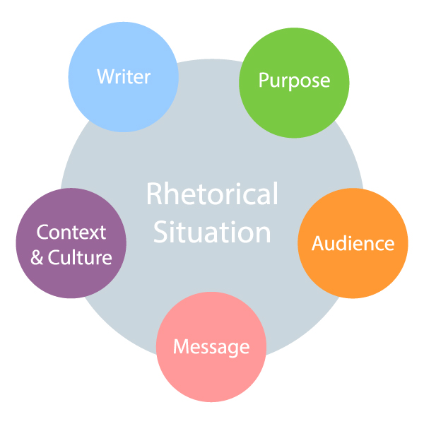

Slide 5
Before you begin writing
Perform an audience analysis
Understand who you are as a writer
Have a clear purpose and message
Be sensitive to the context and culture

Slide 6
So for example…
I want to inform you, my students, that due to a technology issue, the student presentations module is currently hidden from view but will be made available shortly once the issue is resolved. I can only communicate with my students online.

Slide 7
Hyman’s Problem Formulation
Need statement: recognizes and describes the need for a solution or improvement to an “unsatisfactory situation.”
Goal statement: describes what the improved situation would look like once a solution has been implemented.
Objectives: define measurable, specific outcomes that any feasible solution should optimize (aspects you can use to “grade” the effectiveness of the solution).
Constraints: define the limits that any feasible solution must adhere to in order to be acceptable (pass/fail conditions, range limits, etc.).

Slide 8
In our example…
Need: to inform my students about the technical foul up with the presentation module
Goal: that they will know when the module is available and not to panic in the meantime
Objectives: a clear message that relays the information while adhering to the 7 C’s of Technical Commuication
Constraints: can only be online

Slide 9
Purpose
What is the function of this document?
to create a record, such as a lab report or procedures followed documentation?
to give or request information, such as an instruction manual?
to persuade, such as a proposal or a recommendation report?
Use the 5 Ws: (Who, What, Where, When, Why (and How)

Slide 10
Writer
What is your motivation as a writer?
What biases, past experiences or knowledge do you bring to your writing?
What is your role within the larger organization as a writer?
What is your position relative to the target audience?

Slide 11
In our example…
I want to alleviate any concerns while the technical issue is resolved
I remember what it was like as a student when not all the information was available
I am writing as your course instructor, in a supervisory role, and ultimately responsible for the course content

Slide 12
Audience
Consider who will be reading this document.
Audience | Purpose for Reading
Executives | Make decisions
Supervising Experts/Managers | Advise decision makers; direct subordinates
Technical Experts/Co-workers | Implement decisions; advise
Lay People/Public/Clients | Become informed; choose options; make decisions

Slide 13
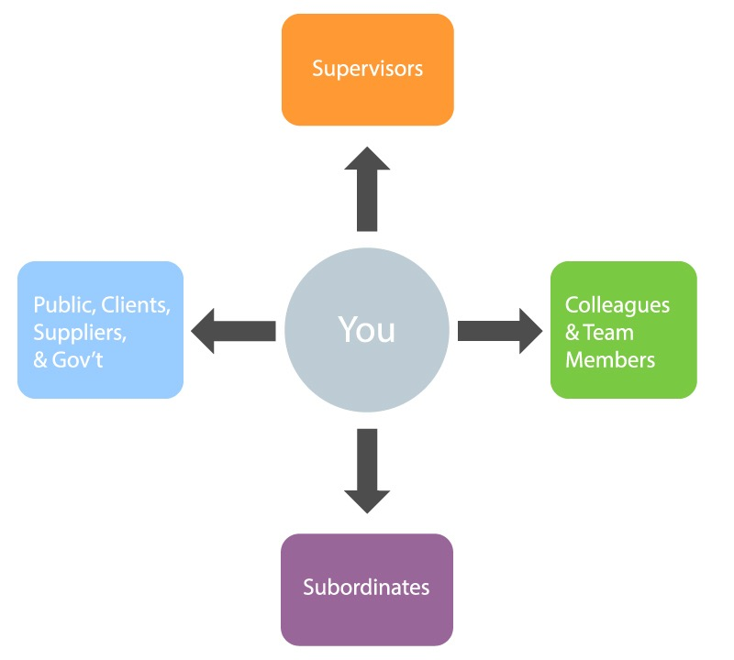

Slide 14
Develop an audience profile
Who are your primary readers? (specific names and titles, or general roles)
Are they above you in the organizational hierarchy? Lateral, subordinate? Outside of your organization?
Who else might read this document? (secondary readers)
Do you know what their attitude towards the topic is?
How might cultural differences affect their expectations and interpretations?
How much technical background do the readers have?
How much do they already know about the topic?
What situation gave rise to this document?

Slide 15
In our example…
You, the students, are my audience
Our TA will also read this document
My students’ attitude is unknown, but I assume they will be interested to know why they can’t access one of their assignments
I cannot assume any technical background or understanding of Brightspace
A technical snafu gave rise to the need for this document.

Slide 16
Message/Tone
What is the information you want to deliver? And, perhaps more importantly, what is the tone of that message?
Tone can be defined as the attitude conveyed by the piece of writing towards the topic and/or the reader. Using the wrong tone can cause serious problems.
Consider:
a workplace is often hierarchical (implied power relationships)
an effective workplace requires cooperation and teamwork
When thinking about what tone to adopt in a piece of writing, consider
How will your reader(s) feel as a result of reading this?
How do you want your reader(s) to feel?

Slide 17
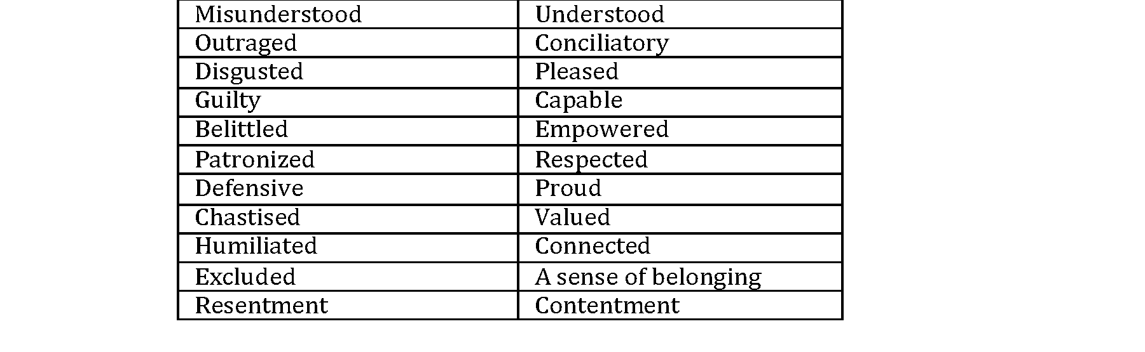
Tone 🡪 Emotional Appeal
What might make readers experience the following feelings, and which will result in more effective workplace :

Slide 18
Maintaining Positive Tone
Focus on being READER-centered rather than writer-centered.
Use positive phrasing instead of negative phrasing
Be respectful and constructive, even when giving bad news or criticism.
Focus on positive result or outcome
Be calm; be the “voice of reason”

Slide 19
In our example…
I will write an email that communicates my understanding of any frustrations and provides assurances that the problem will be resolved shortly.
My tone will be respectful and professional

Slide 20
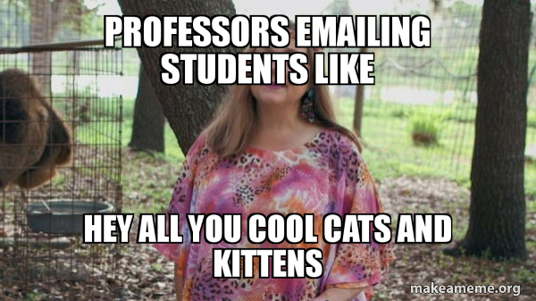

Slide 21
Context
What is the situation that has created the need for the writing?
Context can be affected by:
timing
location
current events
organizational or social culture

Slide 22
In our example…
This message needs to be sent as the semester has started and the technical problem needs to be resolved
I cannot simply post the sign-up sheet because of Covid-19

Slide 23
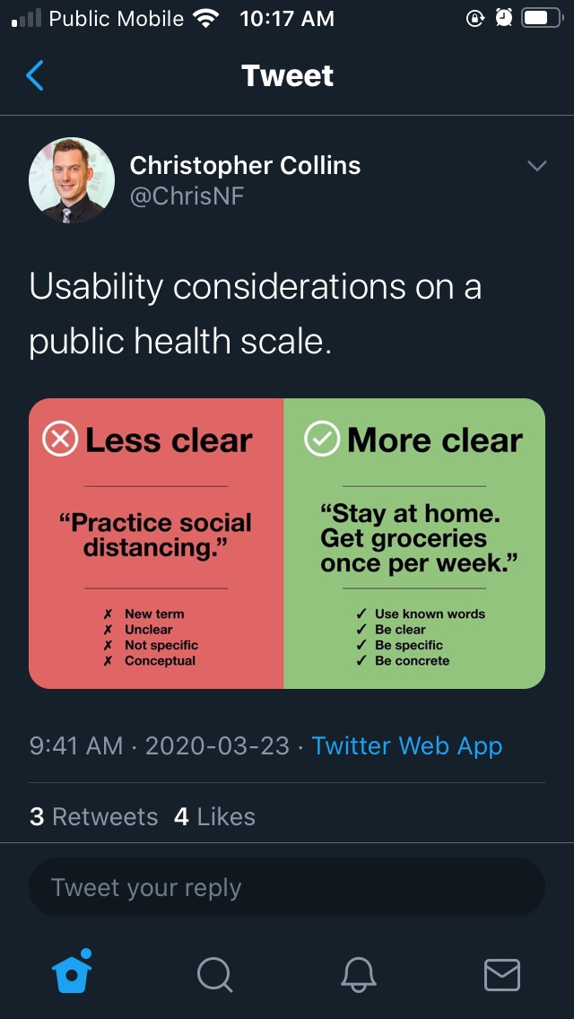

Slide 24
Conclusion
The key concepts in undertaking any workplace communications are
Understanding the PURPOSE (task analysis)
Knowing your AUDIENCE and their needs
Presenting your ideas using the appropriate TONE
Once you have done this, you can begin working on choosing the content and organization that will best suit your purpose and audience.

